Slide 1
Dataset Discovery and Exploration: State-of-the-art, Challenges and Opportunities
Norman Paton and Zhenyu Wu
University of Manchester

Slide 2

Interaction
We have scheduled time for questions / discussion:
5 minutes:
at the end of this introduction.
at the end of each of the four main section.
10 minutes:
At the end of the tutorial.
… but we are also happy to take questions as we go, especially for clarification.

Slide 3
Dataset Discovery and Exploration
Why does it matter?
The problem: data scientists spend a lot of their time collecting and organizing data sets.
The opportunity: there are many underutilized data contexts: open data, data lakes, data onboarding, …
https://www.forbes.com/sites/gilpress/2016/03/23/
data-preparation-most-time-consuming-least-enjoyable-data-science-task-survey-says/?sh=53357b9b6f63

Slide 4
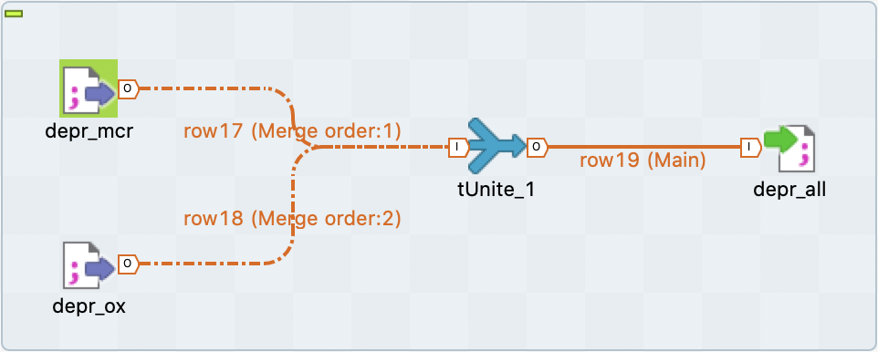
Data Discovery & Exploration for ETL
The ETL tools market was estimated to have been $3.1B in 2021, growing at 14.3% each year (SkyQuest.com).
Every data source node in an ETL workflow has to be discovered.
Every join in an ETL workflow needs to produce a non-empty answer other than by trial and error; every union needs union-compatible inputs.
A. A. A. Fernandes, et al., Data Preparation: A
Technological Perspective and Review. SN Comput. Sci. 4(4): 425 (2023)

Slide 5
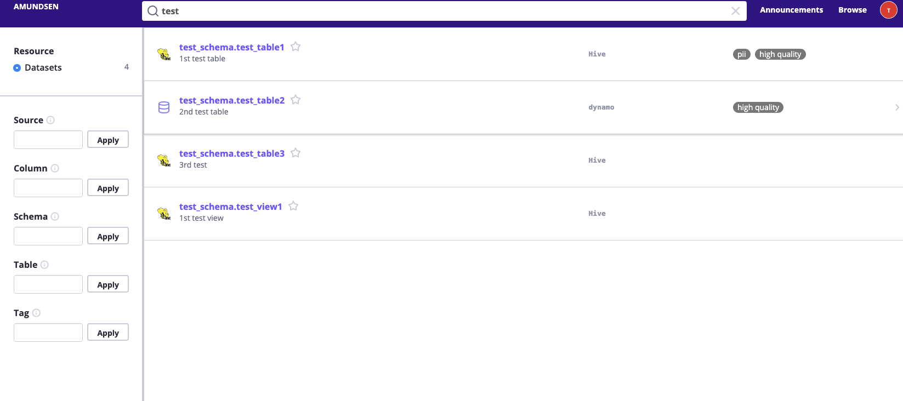
Dataset Discovery & Exploration for Catalogs
The Data Catalog market was estimated to have been $0.7B in 2021, predicted to grow to $1.8B in 2027 (marketsandmarkets.com).
Data catalogs have wider roles than Discovery & Exploration (e.g., governance), but their utility with data lakes and open data seems likely to depend on automation and abstraction.
https://www.amundsen.io/amundsen/

Slide 6
Dataset Discovery & Exploration for AutoML
The AutoML market was estimated to have been $1.0B in 2022, predicted to grow to $6.4B in 2028 (marketsandmarkets.com).
AutoML workflows often contain data ingestion and data preprocessing steps, so advances in Dataset Discovery & Exploration can contribute to upstream AutoML pipelines.
Import Data
Preprocess Data
Extract Features
Train Model
Evaluate
Deploy

Slide 7
An attempt at some definitions
Dataset discovery is the process of identifying datasets that may meet an information need. This may, for example, be done directly through a search, by navigating from related datasets, or by browsing the datasets with a specific annotation.
Dataset exploration is the process of understanding the properties of datasets and the relationships between them. This may, for example, be carried out by exploring the relationships of a given dataset, by viewing shared annotations at dataset or attribute level, or by exploring relationships that are shared by several datasets in an inferred schema.

Slide 8
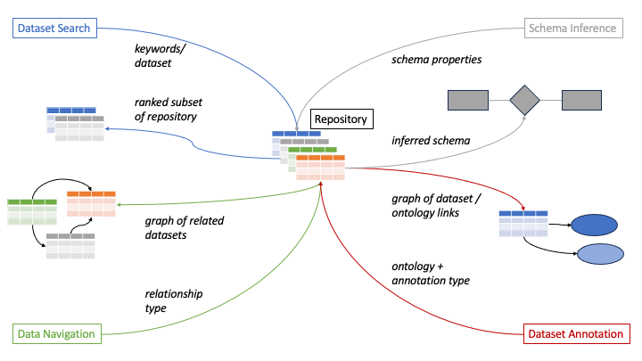
Functionalities of Discovery and Exploration

Slide 9
Foundation: Similarity
All the previous functionalities build on similarity:
Dataset Search:
Find datasets like this one; which datasets match these keywords?
Dataset Navigation:
Find attributes that can be joined on; find semantic relationships.
Dataset Annotation:
Find concepts in an ontology that describe values in this column.
Schema inference:
Cluster together related tables; cluster the attributes of those tables.

Slide 10
Similarity: Syntactic
Syntactic similarity captures relationships between tokens or collections of tokens.
Syntactic similarity may involve complete attribute values, e.g., Jaccard similarity of sets of values.
Syntactic similarity may involve partial values, e.g., Jaccard similarity of sets of n-grams.
Example problem: Given a column C, find other columns that have the largest overlap with C.
C2
A
B
C
E
F
C
A
B
C
D
C1
A
C
E
F
C3
A
B
<
>
Erkang Zhu, et al., JOSIE: Overlap Set Similarity Search for
Finding Joinable Tables in Data Lakes. SIGMOD 2019: 847-864

Slide 11
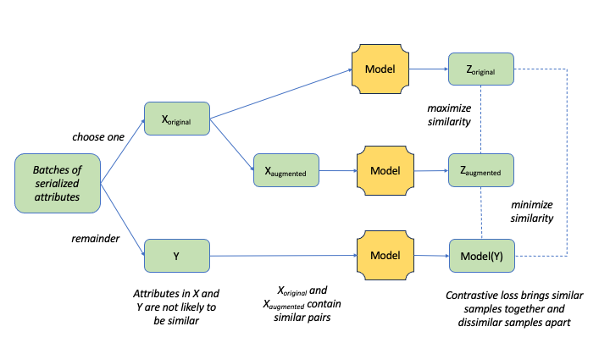
Similarity: Semantic
Semantic similarity captures relationships between the meaning of table, column, row or cell values, which may or may not be syntactically similar.
Semantic similarity then often builds on word embeddings or language models to identify relationships between data model constructs.
Task-specific embeddings can be created, e.g., for column comparison using by fine-tuning with contrastive learning.
Grace Fan, et al., Semantics-aware Dataset Discovery from Data Lakes with Contextualized Column-based Representation Learning. PVLDB 16(7): 1726-1739 (2023)

Slide 12
Similarity: Scaling it Up
Identifying similarity at scale tends to involve indexes, which may be:
Within algorithms (e.g., JOSIE from Syntactic Similarity has an inverted index linking values to collections).
Generic structures (e.g., Locality Sensitive Hashing (LSH) has been used by several search and navigation proposals).
In LSH:
similar values → similar hash code. Collisions in the hash table represent potential duplicates.
For a given hash function, similar values can have different hash codes, so several different hash functions/tables are used.
LSH can be used to approximate several classical similarity measures, such as Jaccard or Cosine.
Mayank Bawa, Tyson Condie, Prasanna Ganesan:
LSH forest: self-tuning indexes for similarity search.
WWW 2005: 651-660

Slide 13
Demonstration Notebook
This tutorial is accompanied by a Python Notebook that will be used to illustrate concepts as we go along and that can also be explored after the tutorial.
The Notebook (and these slides) can be downloaded from:
https://github.com/PierreWoL/EDBTDemo

Slide 14

Any Questions / Comments?

Slide 15
Functionality 1: Dataset Search

Slide 16
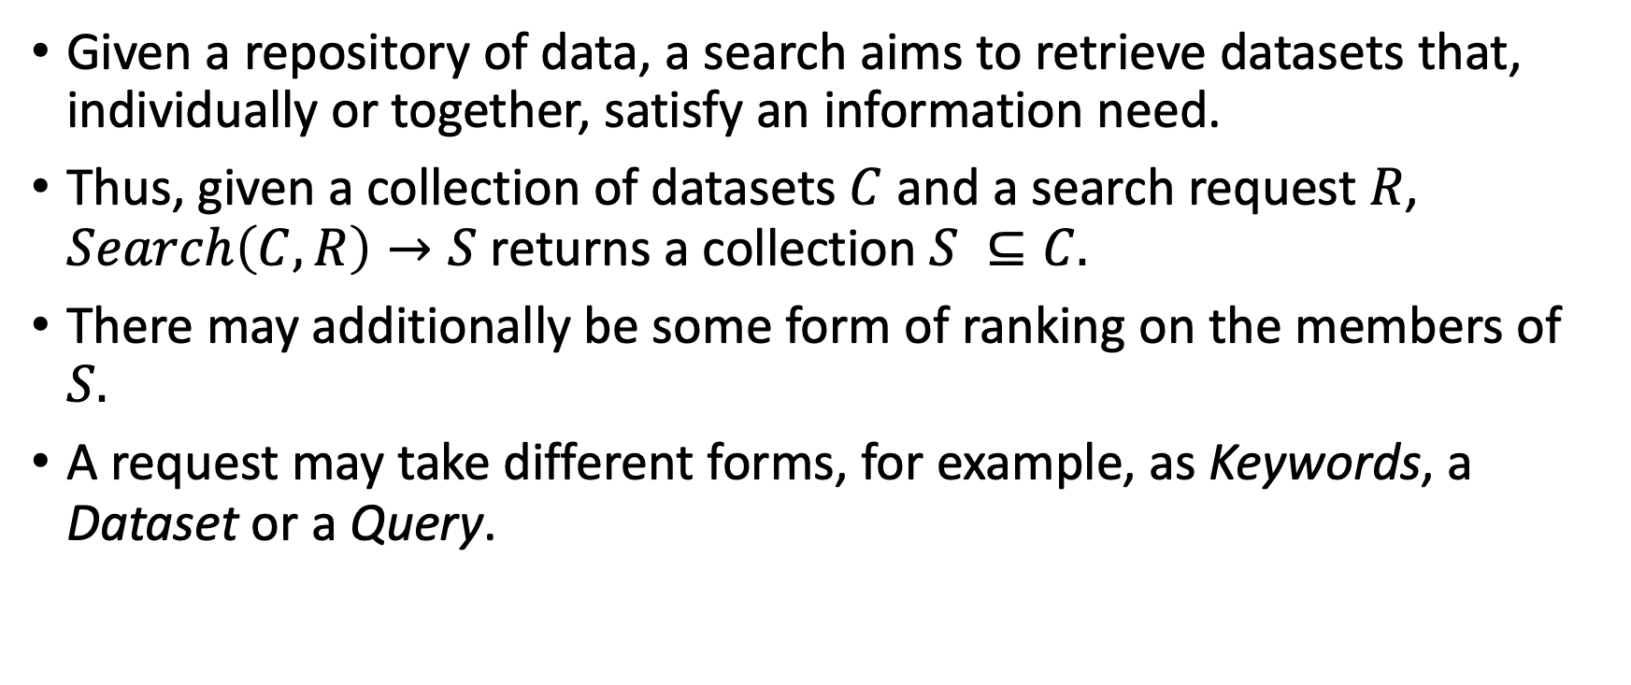
Dataset Search: A Signature
Given a repository of data, a search aims to retrieve datasets that, individually or together, satisfy an information need.
Thus, given a collection of datasets $C$ and a search request $R$, $Search\left(C,R\right)→S$ returns a collection $S ⊆C.$
There may additionally be some form of ranking on the members of $S.$
A request may take different forms, for example, as Keywords, a Dataset or a Query.

Slide 17
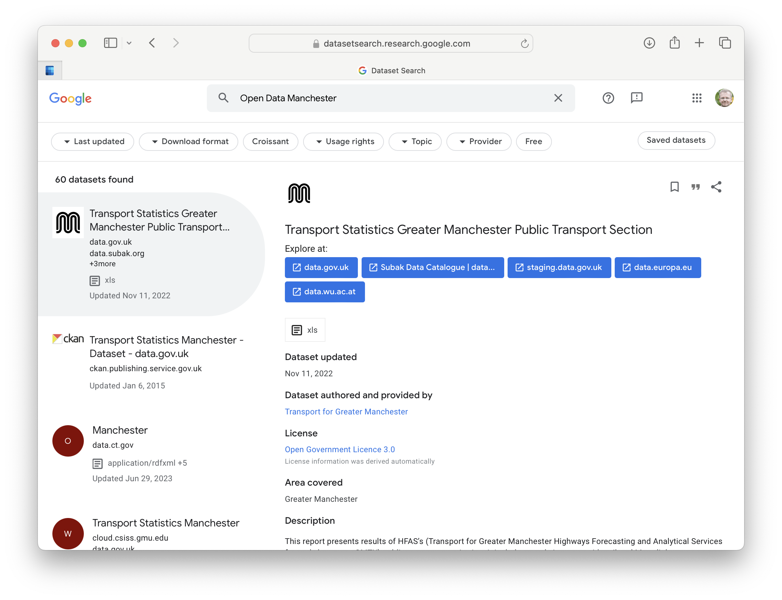
Dataset Search: Keyword
Keyword search allows users to target data with minimal knowledge of dataset structure and relationships.
Keyword search can apply to dataset header and/or body and/or annotations.
There is a survey that focuses on this area:
Example: Google Dataset Search is a keyword search over annotations provided by data publishers.
Chapman, et al., Dataset search: a survey.
VLDB J. 29(1): 251-272 (2020)

Slide 18
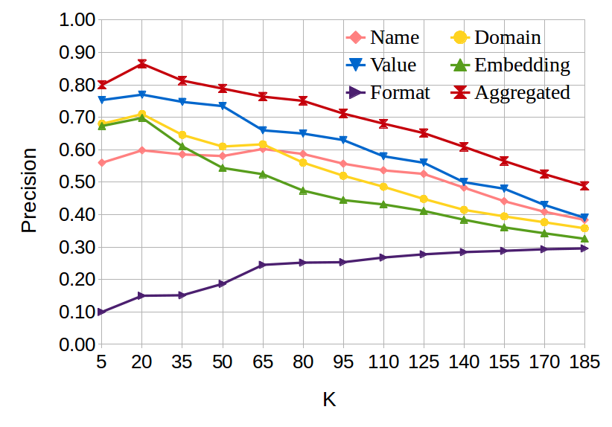
Dataset Search: Table Header / Body
Given a dataset, perhaps from other search or navigation tasks, looks for other datasets with similar Header and/or Body values to identify “more data like this”.
A version of this search is the Table Union Search problem that prioritises unionable tables rather than considering other notions of similarity.
Proposals may combine different indexes. Here index performance is compared in D³L.
A. Bogatu, A.A.A. Fernandes, N.W. Paton, N. Konstantinou:
Dataset Discovery in Data Lakes. ICDE 2020: 709-720

Slide 19
Dataset Search: Query
Query driven search seeks to support more precise requests. This could involve:
Adding Boolean operators around keyword searches.
Defining a model for structured data and a language over that model, where the operations in the language include search tasks.
In Aurum:
The model is a graph; nodes are columns in a repository, and edges represent relationships between the columns.
The language contains functions for keyword search of headers, to identify columns that are similar to a given column, etc.
The following identifies tables with columns that are similar to those in School1 that mention London.
drs = columns("School1")
res = table(match(drs)) AND table(valueSearch("London"))
R.C. Fernandez, Z. Abedjan, F. Koko, G. Yuan, S. Madden, M. Stonebraker: Aurum: A Data Discovery System. ICDE 2018: 1001-1012

Slide 20
Behind the scenes: D³L – Overview
Dataset Discovery in Data Lakes (D³L) searches for tables by composing 5 Header or Body similarity measures. These measures relate to:
Attribute names.
Attribute values.
Attribute formats.
Word embeddings.
Numerical distribution.
1 – 4 use LSH indexes.
Results are ranked based on a weighted Euclidean distance between source and target attributes over the distances for the 5 similarity measures.
Attribute Names
Employee
Joe Bloggs
Stephen Fry
Worker
Joseph Blogger
Hugh Lawrie
Attribute Values
Attribute Format

Slide 21
Behind the scenes: D³L – Relationships
D³L also considers relationships when ranking search results.
In the example:
If A is the subject column of each table.
Assume the search is for Target, and Source-1 is in in the top-k.
Then if Source-1.A overlaps with Source-2.A, the join of Source-1 with Source-2 on A may be more similar to the Target than Source-1 alone.
This illustrates that Dataset Search and Data Navigation are potentially overlapping concerns.
Target
A | B | C | D | E
Source-1
A | B | C | D | F | G
⑅
Source-2
A | E | P | Q

Slide 22
Aside: Subject Columns
The subject column / subject attribute of a dataset describes the entity the dataset is about.
Title of a movie.
Name of a city.
The subject column can then play a role analogous to the primary key, for example when looking for relationships between datasets or grouping related datasets.
Subject columns have been inferred by machine learning or using heuristics.
Petros Venetis, Alon Y. Halevy, Jayant Madhavan, Marius Pasca, Warren Shen, Fei Wu, Gengxin Miao, Chung Wu: Recovering Semantics of Tables on the Web. Proc. VLDB Endow. 4(9): 528-538 (2011)
Ziqi Zhang: Effective and efficient Semantic Table
Interpretation using TableMiner+. Semantic Web
8(6): 921-957 (2017)

Slide 23
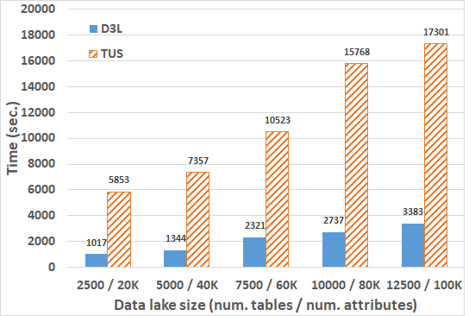
Dataset Search: Benchmarking / Evaluation
Effectiveness can be measured:
Using metrics such as
mean reciprocal rank (if you have a Ground Truth (GT)) rank;
Precision at k (if you just have GT result membership).
Using datasets that
Have been manually annotated, for example with an ontology type (note that things with the same annotation may not be very similar).
Have been generated from some starting datasets, as in Table Union Search (TUS), but beware of unrealistically consistent values.
Scalability can be measured in terms of search time, index creation time and index size.
F. Nargesian, E. Zhu, K.Q. Pu, R.J. Miller: Table Union Search on Open Data. Proc. VLDB Endow. 11(7): 813-825 (2018).
Here TUS is slower loading than D³L due to time spent accessing a knowledge graph; both systems have similar LSH indexes.

Slide 24
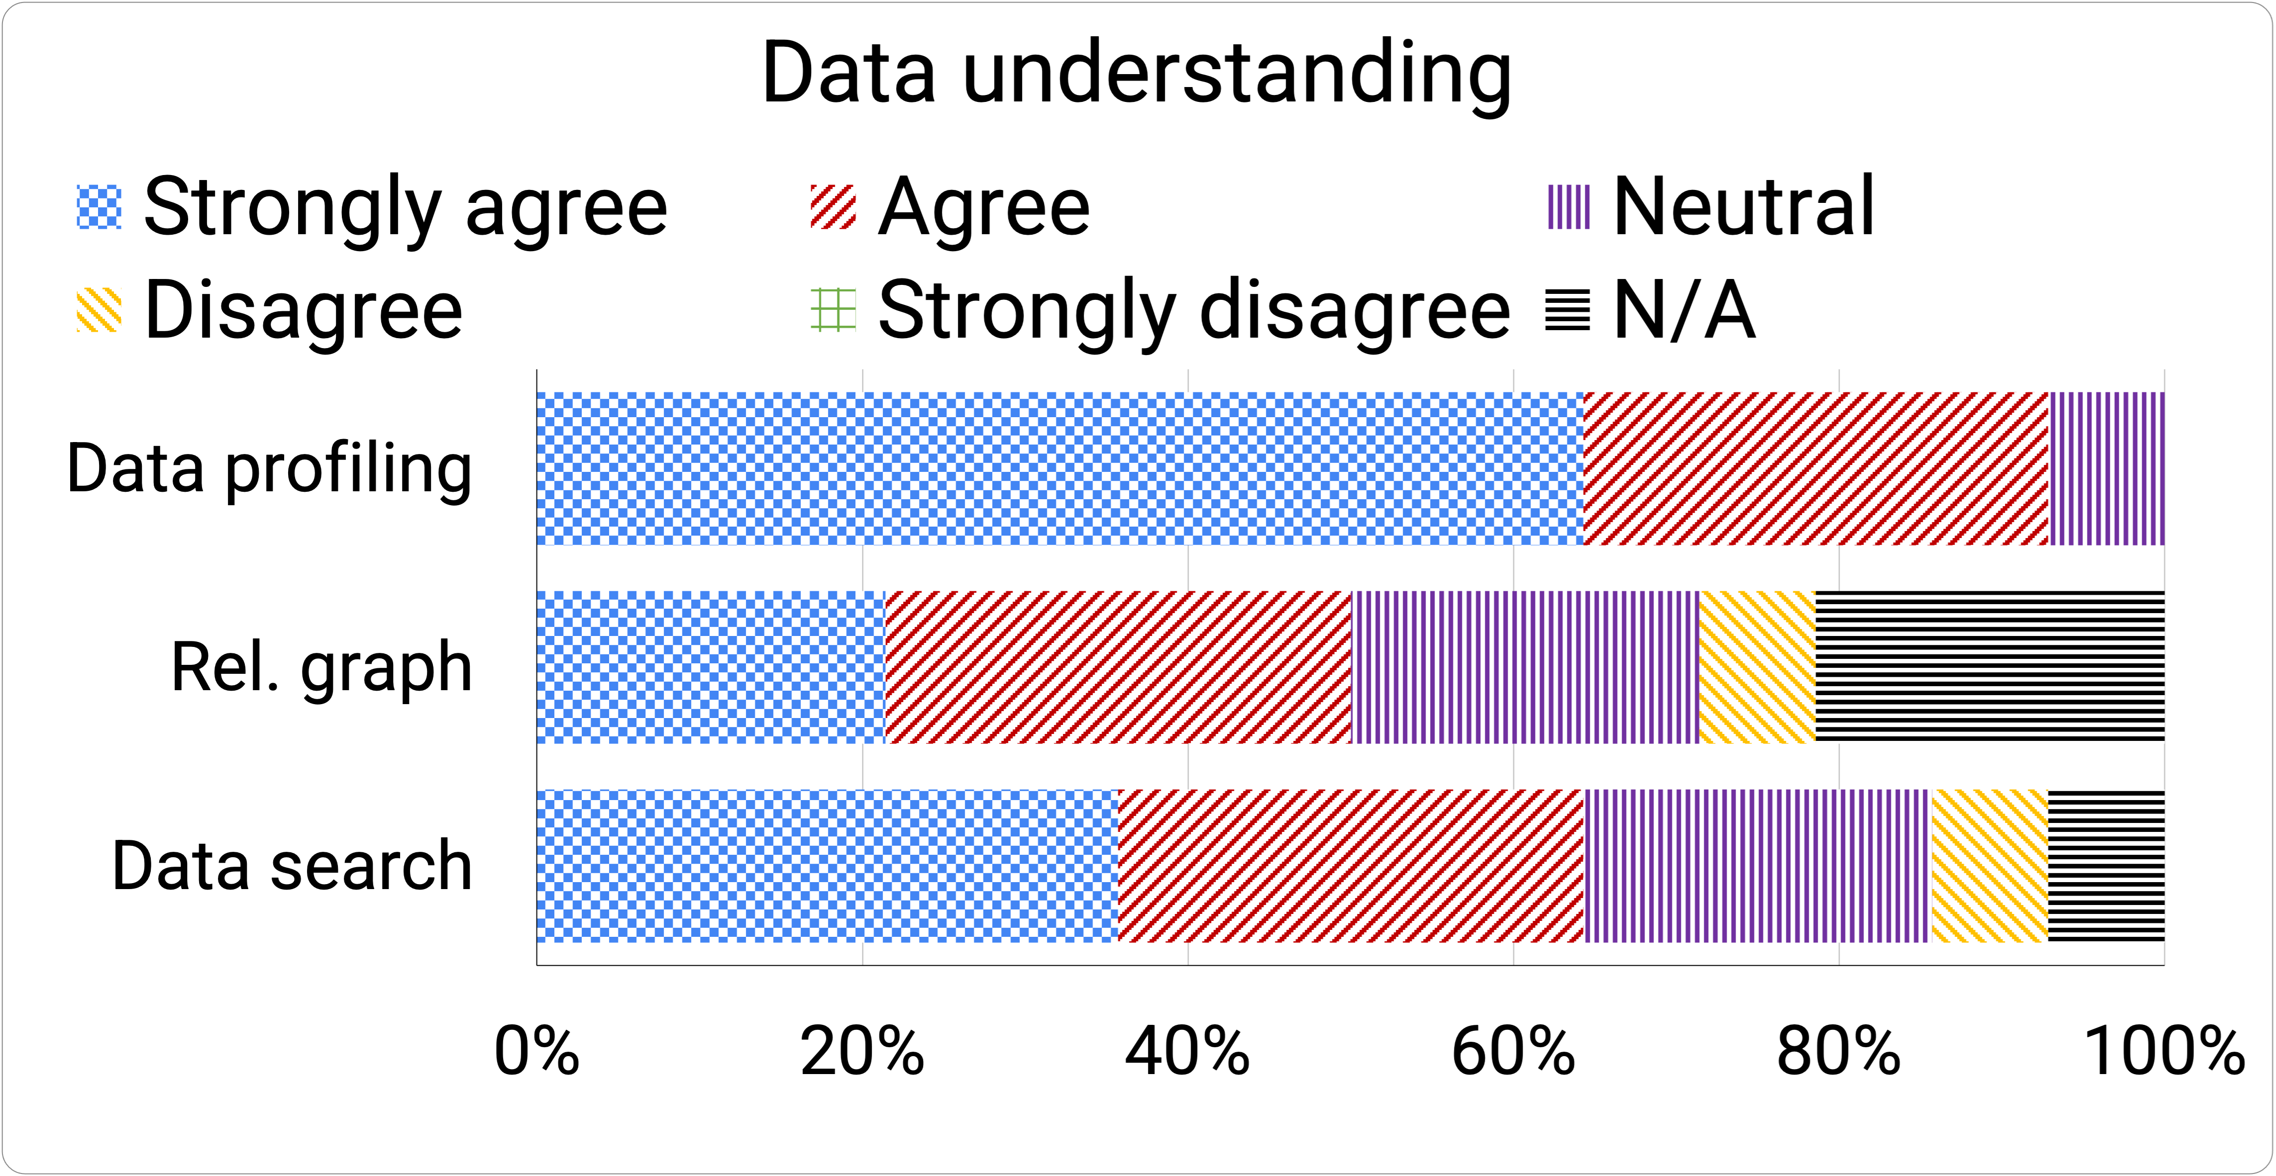
Dataset Search: Conclusions / Directions
Conclusions:
There is considerable diversity in the functionalities explored.
The evidence used to inform searches is typically local.
Directions:
Recent work is exploring the use of language models.
It would be good to have more usability evaluations to identify what is most useful in practice.
Language Models:
G. Fan, et al., Semantics-aware Dataset Discovery from Data Lakes with Contextualized Column-based Representation Learning. Proc. VLDB Endow. 16(7): 1726-1739 (2023)
Usability:
A. Bogatu, et al., Voyager: Data Discovery and Integration for Onboarding in Data Science. EDBT 2022: 2:537-2:548
C. Liu, et al., Governor: Turning Open Government Data Portals into Interactive Databases. CHI 2023: 415:1-415:16.
Voyager questionnaire results show agreement that search
helped with data understanding, though less so than profiling.

Slide 25
Any Questions / Comments?

Slide 26

Demonstration

Slide 27
Functionality 2: Dataset Navigation

Slide 28
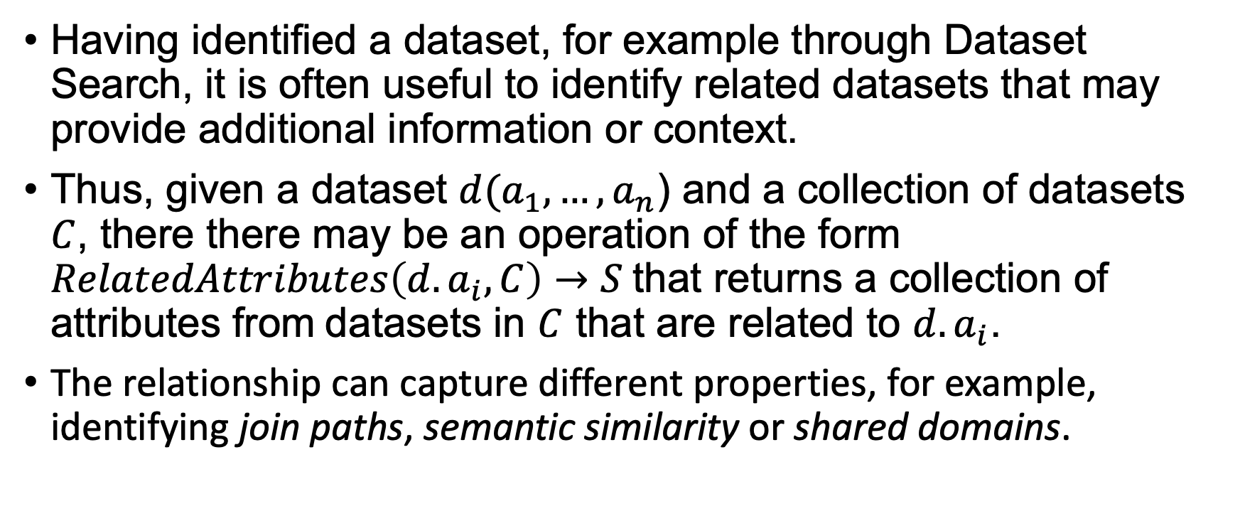
Dataset Navigation: A Signature
Having identified a dataset, for example through Dataset Search, it is often useful to identify related datasets that may provide additional information or context.
Thus, given a dataset $d(a_{1}, …, a_{n}$) and a collection of datasets $C$, there there may be an operation of the form $RelatedAttributes\left(d.a_{i}, C\right)→S$that returns a collection of attributes from datasets in $C$ that are related to $d.a_{i}$.
The relationship can capture different properties, for example, identifying join paths, semantic similarity or shared domains.

Slide 29
Dataset Navigation: Related Areas
Schema matching:
Schema matching searches for similarity relationships between attributes.
Often schema matchers are composite – they combine evidence from different primitive matchers that compute a single metric over a single source of evidence.
The output of schema matching is a ranked list of related attributes.
Data Profiling:
Data profiling derives specific properties of datasets; these are often more pinned down than the notion of a match.
For example, data profiling may identify candidate keys, functional dependencies and inclusion dependencies.
Erhard Rahm, Philip A. Bernstein: A survey of
approaches to automatic schema matching.
VLDB J. 10(4): 334-350 (2001)
Ziawasch Abedjan, Lukasz Golab, Felix Naumann: Profiling relational data: a survey. VLDB J. 24(4): 557-581 (2015)

Slide 30
Dataset Navigation: Join Path Discovery
Join Path Discovery identifies a relationship between datasets that can underpin a join.
Joins depend on extensional similarity, so searching for candidate join paths involves identifying joinable values at the instance level.
Some techniques look for identical values that can be joined directly (with =), and some allow for representational inconsistencies.
Exact:
Town
Manchester
Dagenham
London
City
Manchester
Edinburgh
London
Approximate:
Town
Manchester
Dagenham
London
City
Manchester, England
Edinburgh, Scotland
London, England

Slide 31
Dataset Navigation: Semantic Similarity
It may be useful to navigate between datasets other than to join, for example, to identify semantically related datasets.
Such navigation may link individual datasets or groups of related datasets.
This seems a bit like Dataset Annotation.
Seeping Semantics creates relationships between datasets that reflect the structure of relationships in matching concepts in an ontology.
2
Ontology
1
R.C. Fernandez, et al., Seeping Semantics: Linking
Datasets Using Word Embeddings for Data Discovery.
ICDE 2018: 989-1000
Datasets
3

Slide 32
Dataset Navigation: Domain Discovery
A domain is a collection of values that instantiate an application concept.
For example, Manchester and Venice are both in the domain of Cities.
As with Join Path Discovery, techniques may or may not require values to be represented consistently.
Columns that share a domain could be disjoint, and values can be in several domains.
Note that domain discovery need not name the discovered domains.
Example of columns that share a City domain.
City
Birmingham
Manchester
London
Città
Rome
Venice
Naples
Capitals
Rome
Paris
London
M. Ota, H. Mueller, J. Freire, D. Srivastava: Data-Driven
Domain Discovery for Structured Datasets. Proc. VLDB
Endow. 13(7): 953-965 (2020).
F. Piai, P. Atzeni, P. Merialdo, D. Srivastava: Fine-grained semantic type discovery for heterogeneous sources using clustering. VLDB J. 32(2): 305-324 (2023)

Slide 33
Behind the Scenes: Auto-Join
Auto-Join combines:
approximate row matching with
automatic format transformation
to reformat values in ways that enable equi-joins.
Problem Statement:
Given two tables T_{s}, T_{t}, and a predefined set of operators Ω, find a transformation P = o₁ ·o₂ ·. . . · o_{n}, using operators o_{i} ∈ Ω, such that P(T_{s}) can equi-join with key columns of T_{t}.
Given our earlier example, approximate join path discovery might identify the following tables as join candidates:
Town
Manchester
Dagenham
London
City
Manchester, England
Edinburgh, Scotland
London, England
The problem is to infer a transformation for converting City values into Town values, noting the risk for Manchester, New Hampshire.
Erkang Zhu, Yeye He, Surajit Chaudhuri: Auto-Join:
Joining Tables by Leveraging Transformations.
Proc. VLDB Endow. 10(10): 1034-1045 (2017)

Slide 34
Behind the Scenes: Auto-Join – Row Finding
The first step is to identify matching rows from the source (T_{s}) and target tables (T_{t}).
Auto-join uses syntactic matching based on q-grams from source and target column values.
A value of q is searched for that produces a small but non-empty number of matching values:
too small a q will lead to many spurious matches;
too large a q will lead to no matches.
In the previous example:
Town
Manchester
Dagenham
London
City
Manchester, England
Edinburgh, Scotland
London, England
In the previous example:
2-gram an matches Manchester with every country name and thus is too small.
3-grams seem to align the tuples 1-1.

Slide 35
Behind the Scenes: Auto-Join – Learning Transformations
Auto-join has a collection of string transformation operators:
string[] Split(string v, string sep)
string SelectK(string[] array, int k)
string Concat(string u, string v)
string Constant(string v)
string Substring(string v, int start, int length, Casing c)
There is then a search of the space of operator applications on training data consisting of matched values from T_{s} and T_{t}.
The recursive search looks for transformations that when applied to the the start (resp. end) of the source examples give results that are nearer to the target.
To scale to large tables, matching rows are sampled at a level that gives a high probability that enough matching pairs, P, are sampled for each transformation.

Slide 36
Dataset Navigation: Benchmarking / Evaluation
Problem | Comment | Criteria | Datasets
Join Path Discovery | Approach may produce exact or approximate result. | If exact result, then main concern is scalability. If result is not exact, then need to construct a Ground Truth on smaller repositories. | Open government or web table datasets can be used to test scalability.
Semantic Similarity | Results here are more subjective – what items are really related? | Main concerns are: Suitability of result, e.g., with reference to Ground Truth / users. Scalability. | Tend to require manually produced Ground Truth for suitability. Note suitability and not correctness – results may be subjective.
Domain Discovery | A key differentiator of methods is accommodation of representational inconsistencies.

Slide 37
Dataset Navigation: Conclusions / Directions
Dataset navigation seems to involve either:
A well-defined problem (join path discovery) with a crisp Ground Truth.
More subjective similarity-based relationships with correspondingly more subjective Ground Truths. A repository may not lend itself to a single interpretation.
Note that Dataset Navigation is related to Schema Inference, as inferred schemas need to account for relationships.
Example of subjective Ground Truth.
What are the ground truth domains:
Organisation:
Company.
Technology Company.
Sports Club.
Government.
Government Department.
What are the ground truth associations:
Person has-association-with Organisation.
Employee works-for Company.
Person is-board-member-of Company.
Doctor medical-practitioner-of Hospital.

Slide 38
Any Questions / Comments?

Slide 39
Demonstration

Slide 40
Dataset Discovery and Exploration: State-of-the-art, Challenges and Opportunities
Part 2
The accompanying Python Notebook (and these slides) can be downloaded from:
https://github.com/PierreWoL/EDBTDemo

Slide 41
Recap: Functionalities. We have done Search & Navigation
1
4
2
3

Slide 42
Functionality 3: Dataset Annotation

Slide 43
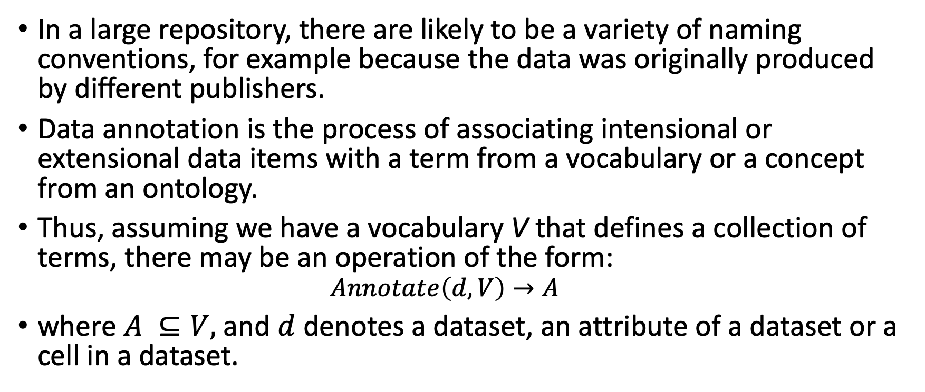
Dataset Annotation: A Signature
In a large repository, there are likely to be a variety of naming conventions, for example because the data was originally produced by different publishers.
Data annotation is the process of associating intensional or extensional data items with a term from a vocabulary or a concept from an ontology.
Thus, assuming we have a vocabulary V that defines a collection of terms, there may be an operation of the form:
$$Annotate\left(d, V\right)→A$$
where $A ⊆V,$and $d$ denotes a dataset, an attribute of a dataset or a cell in a dataset.

Slide 44
Dataset Annotation: Entity Annotation
Entity annotation acts at the instance level, to pin down the interpretation of a token or string.
Entity annotation can be used either directly to support user-level tasks such as search or as a step towards other types of annotation.
Entity annotation can build on syntactic similarity or on language models to provide more context
(e.g., TURL pre-trains and fine tunes representations for tables).
Like other forms of annotation, it depends on ontology coverage.
Entity annotation typically applies to named entities in datasets.
DBpedia URI
Città
Rome
Venice
Naples
http://dbpedia.org/resource/Rome
https://dbpedia.org/page/Rome_(TV_series)
https://dbpedia.org/page/Roman_Empire
X. Deng, et al., TURL: Table Understanding through
Representation Learning. Proc. VLDB Endow. 14(3):
307-319 (2020).

Slide 45
Dataset Annotation: Semantic Type Annotation
Semantic type annotation associates a complete dataset with an annotation.
The semantic type of a table could be inferred from the entity annotations of its subject attribute, from other headers, …
The available evidence likely differs from dataset to dataset.
Semantic type annotation is related to type identification in schema inference, but the latter may not need ontology coverage.
http://dbpedia.org/ontology/city
Città | Popolazione
Rome | 4,355,725
Venice | 258,685
Naples | 3,115,320

Slide 46
Dataset Annotation: Property Annotation
Individual attributes can be annotated at different levels:
Literal types such as URLs, phone number can be inferred, for example from regular expressions.
Semantic types can be inferred from entity annotations or by directly matching with a knowledge base.
There may be iterative refinement of entity, type and property annotations, as none of them exist in isolation.
In addition to annotating named entities, Neumaier et al., explored annotating numerical properties with properties from knowledge graphs (e.g., dbp:years), considering:
Distance between numerical features (min/max value, mean, standard deviation).
Distribution similarity using Kolmogorov-Smirnov (KS) distance.
S. Neumaier, et al.: Multi-level Semantic Labelling of
Numerical Values. ISWC (1) 2016: 428-445

Slide 47
Behind The Scenes: TableMiner+
Infer Subject Column
Entity Inference
Initial Column Annotation
Update Annotations
Relation Annotation
TableMiner+ iteratively combines several unsupervised table annotation tasks:
Subject column inference.
Entity annotation.
Property annotation.
Relation annotation.
From these, relation annotation infers the nature of the relationship between the subject column and other columns.
TableMiner+ focuses on named entity columns.
Ziqi Zhang: Effective and efficient Semantic Table
Interpretation using TableMiner+. Semantic Web
8(6): 921-957 (2017)

Slide 48
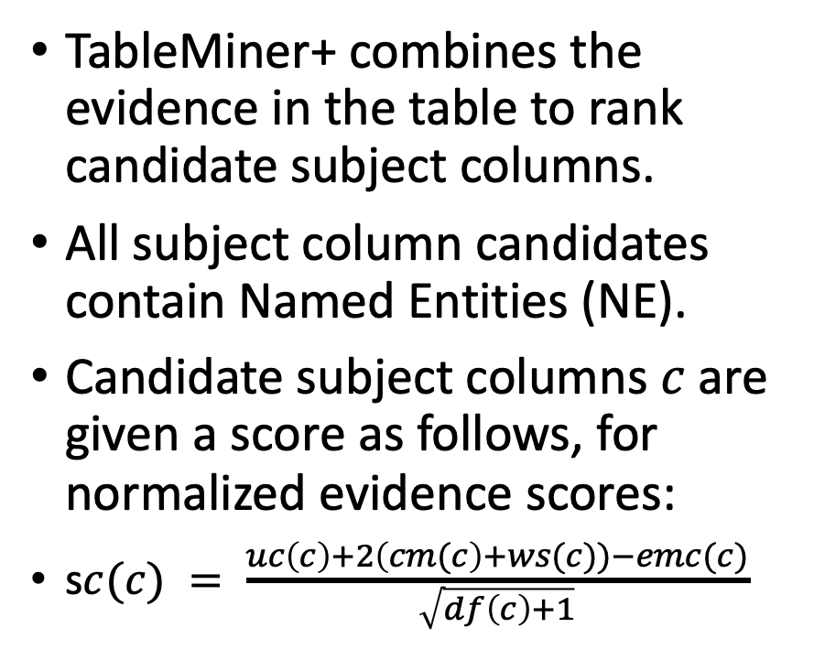
Behind The Scenes: Subject Column in TableMiner+
TableMiner+ combines the evidence in the table to rank candidate subject columns.
All subject column candidates contain Named Entities (NE).
Candidate subject columns $c$are given a score as follows, for normalized evidence scores:
s$c(c) = \frac{uc\left(c\right)+2\left(cm(c\right)+ws(c))−emc(c)}{\sqrt{df\left(c\right)+1}}$
Notation | Feature
emc | Fraction of empty cells
uc | Fraction of cells with unique content
df | Distance from first NE column
cm | Context match score: frequency of header words in values
ws | Web search score: for each row, the frequency of words from this column in a search involving the words from all columns.

Slide 49
Behind The Scenes: Column Annotation in TableMiner+
Initial column annotation is based on the annotations of entities in the column.
The selected annotation for a column depends on annotations of sampled rows and the table’s context (e.g., caption for web tables).
TableMiner+ samples rows until adding new rows has little impact on the candidate annotations.
When all columns have been annotated, the weights of all candidate concepts are updated based on concepts in other columns, and column annotations recomputed. This process then iterates until stable.
DBpedia URI
Città
Rome
Venice
Naples
https://dbpedia.org/ontology/capital
https://dbpedia.org/ontology/City

Slide 50
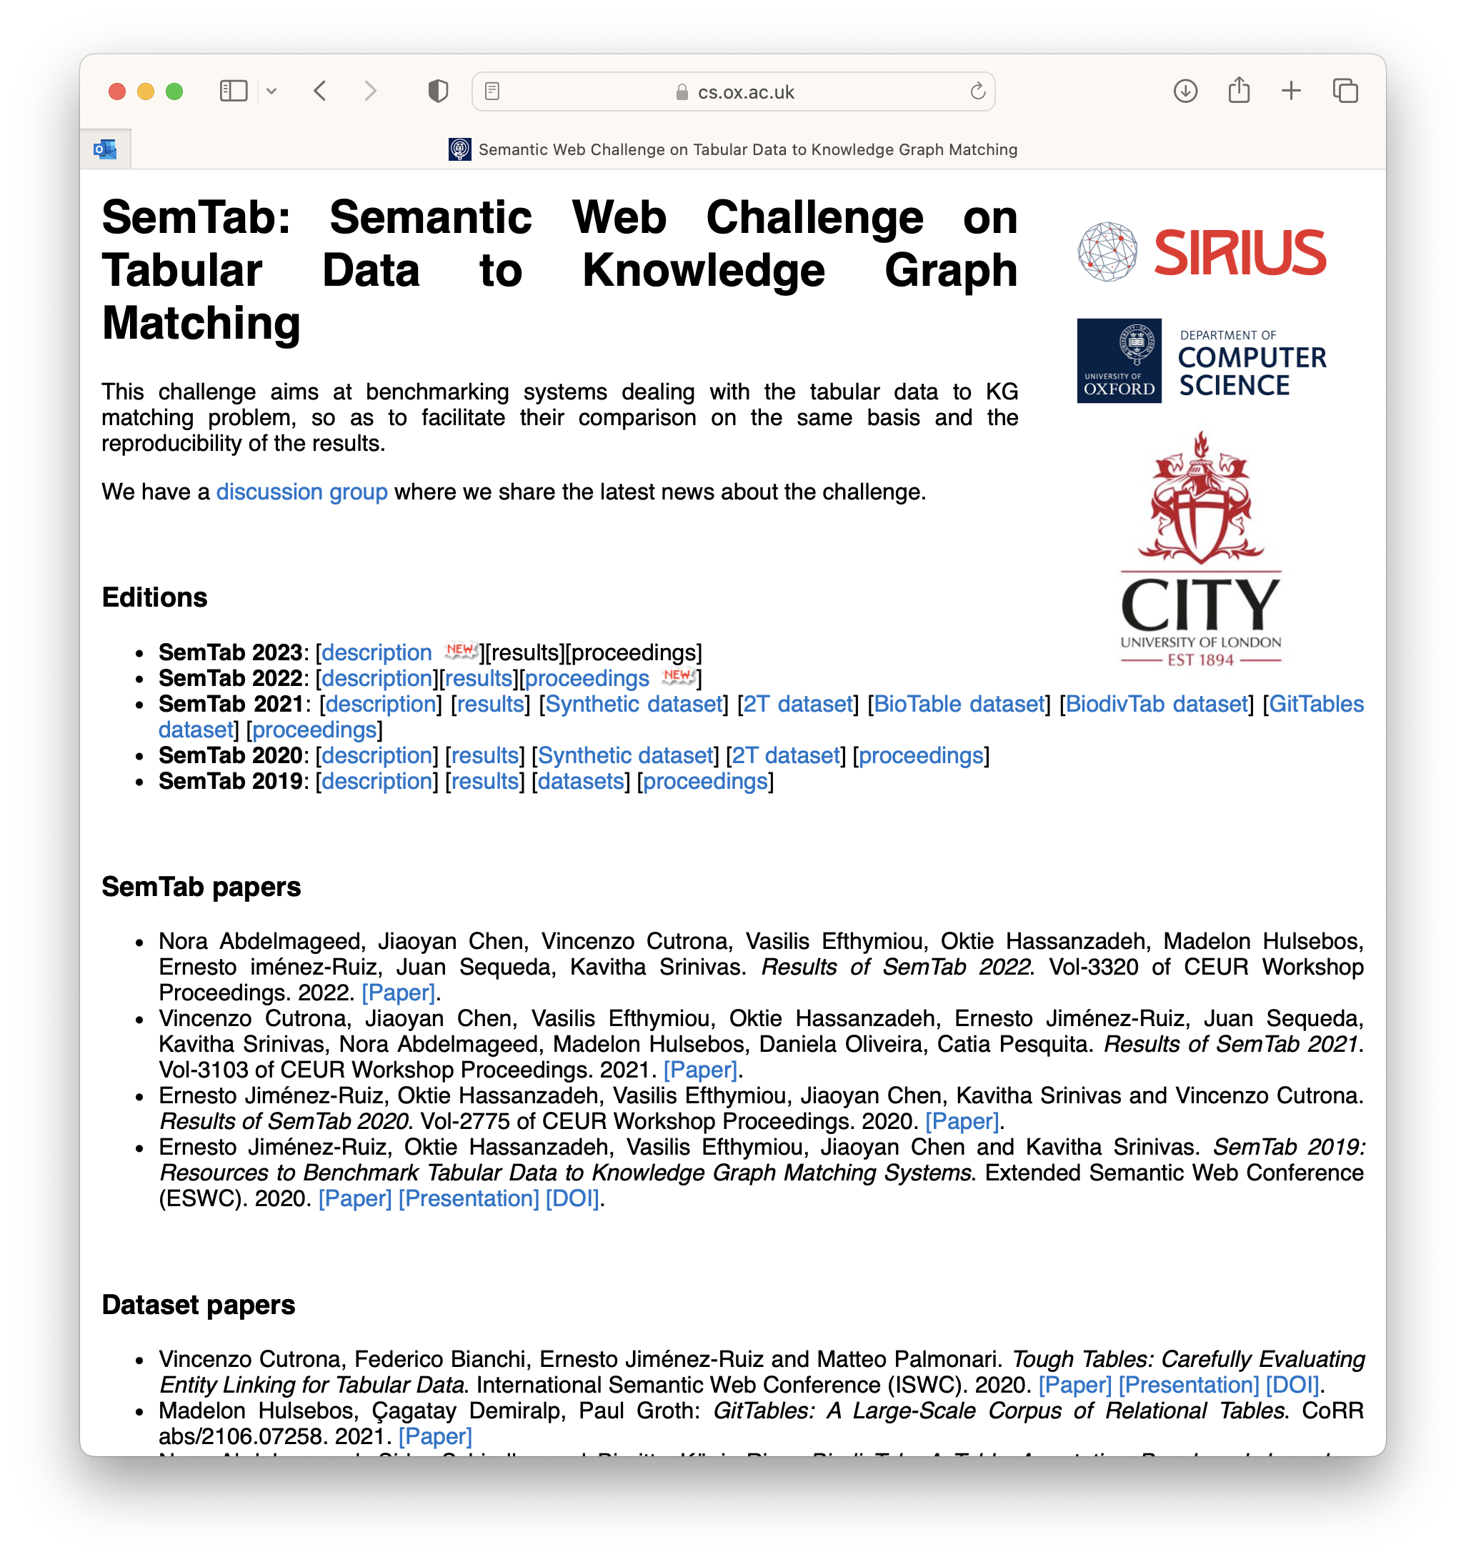
Dataset Annotation: Benchmarking / Evaluation
Effectiveness tends to be measured using metrics such as precision and recall against benchmark datasets, such as the one cited below.
Achilles Heels:
annotation utility depends on ontology coverage;
an ontology may not reflect the aspects of the domain that are relevant to an application.
SemTab is a competition in this area:
D. Ritze, C. Bizer: Matching Web Tables To DBpedia - A Feature Utility Study. EDBT 2017: 210-221

Slide 51
Dataset Annotation: Conclusions / Directions
Dataset annotations can support a variety of tasks:
Keyword search can search for annotations.
Dataset search can search for datasets with the same annotation.
Domain discovery can search for consistent column annotations.
Dataset annotation tends to be carried out in isolation from:
Other Discovery and Exploration techniques, such as those for the tasks to the left.
Schema inference, where annotations tend to be used only when working with born-annotated datasets.
The application for which the data is to be used.

Slide 52
Any Questions / Comments?

Slide 53
Demonstration

Slide 54
Functionality 4: Schema Inference

Slide 55
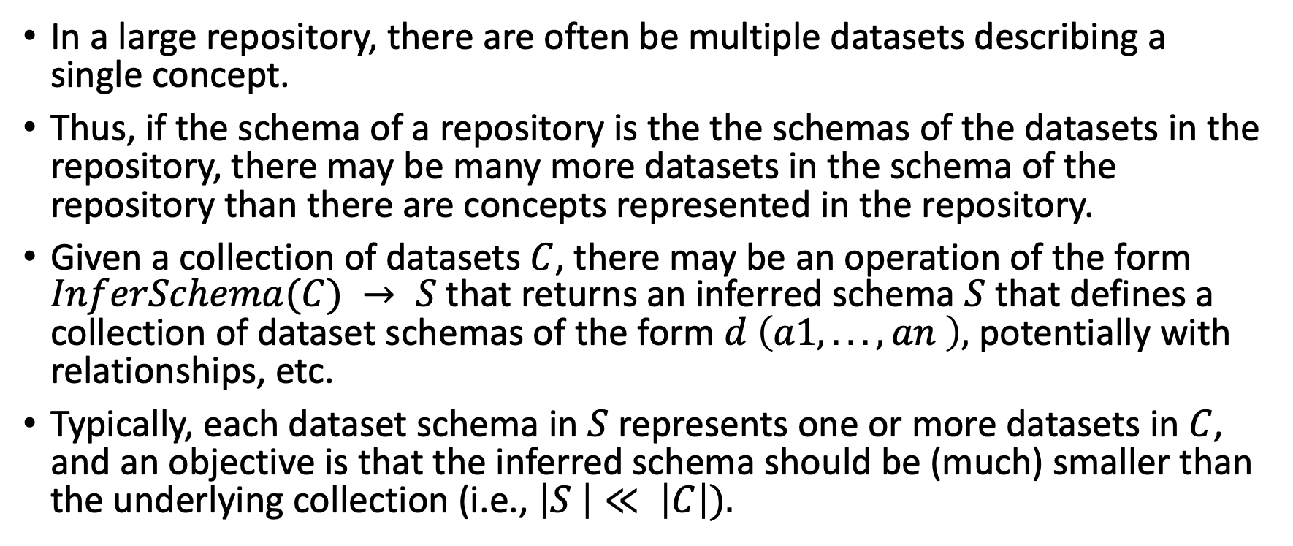
Schema Inference: A Signature
In a large repository, there are often be multiple datasets describing a single concept.
Thus, if the schema of a repository is the the schemas of the datasets in the repository, there may be many more datasets in the schema of the repository than there are concepts represented in the repository.
Given a collection of datasets $C$, there may be an operation of the form $InferSchema(C) → S$that returns an inferred schema $S$ that defines a collection of dataset schemas of the form $d \left(a1, . . . , an \right),$ potentially with relationships, etc.
Typically, each dataset schema in $S$ represents one or more datasets in $C$, and an objective is that the inferred schema should be (much) smaller than the underlying collection (i.e., $\left|S \right|≪ \left|C\right|).$

Slide 56
Schema Inference: Relationship to Dataset Annotation
Dataset annotation and schema inference share the goal of identifying recurring concepts in a repository and may identify such recurring concepts at dataset or attribute level.
Schema inference (normally) differs from dataset annotation by not requiring an external ontology to define the concepts that may be present in a repository.
Dataset annotations could inform schema inference, or support naming of inferred schema constructs.
A | B | C
U | V | W | X
Infer Schema
A | C
U | V | X
A | B | C
U | V | W
Dataset Annotation
A
C

Slide 57
Schema Inference: For Querying
In Schema Inference for Querying, the aim is to infer a schema that describes the underlying data precisely, so that it can be queried.
Thus, every construct in the underlying datasets is present in the inferred schema.
This approach does not resolve representational inconsistencies, and generally assumes that the underlying documents are somewhat similar.
This approach has primarily been pursued for XML and JSON.
For example, schemas of two JSON document fragments:
{𝑛𝑎𝑚𝑒 : 𝑆𝑡𝑟, 𝑝𝑜𝑠𝑡𝑐𝑜𝑑𝑒 : 𝑆𝑡𝑟 }
{𝑛𝑎𝑚𝑒 : 𝑆𝑡𝑟, 𝑎𝑑𝑑𝑟𝑒𝑠𝑠 : 𝑆𝑡𝑟 }
A possible fused schema is:
{𝑛𝑎𝑚𝑒 : 𝑆𝑡𝑟, 𝑝𝑜𝑠𝑡𝑐𝑜𝑑𝑒 : 𝑆𝑡𝑟 ?, 𝑎𝑑𝑑𝑟𝑒𝑠𝑠 : 𝑆𝑡𝑟 ?}
Note that in the fused schema, postcode and address can appear together, whereas they cannot in the original fragments.
M.A. Baazizi, et al., Schema Inference for Massive JSON
Datasets. EDBT 2017: 222-233

Slide 58
Schema Inference: For Documenting
In more unruly settings, where there are many independent publishers, it is common to infer a schema that:
broadly retains the same level of detail in sources, but
abstracts over (some) representational inconsistencies.
There are many examples of this approach for RDF data.
RDF Instance Extraction
Build Candidate Descriptions
Cluster Candidate Descriptions
Identify Recurring Features
Infer Schema
K. Christodoulou, et al., Structure Inference for Linked
Data Sources Using Clustering. Trans. Large Scale Data
Knowl. Centered Syst. 19: 1-25 (2015)

Slide 59
Schema Inference: For Summarizing
The previous approaches infer complete (querying) or fairly comprehensive (documenting) schemas.
For a large repository, such a schema may be huge; it may still be difficult to get a good impression as to the main areas covered.
Thus, a summary tries to identify a much more concise result, perhaps of a given size:
what are the 10 most important datasets in this repository?
In the paper cited, an initial hierarchal schema is simplified so that groups of nodes (not necessarily at the same level) are replaced by a single representative node, based on connectivity, cardinality and coverage.
Site
Region
Africa
Asia
Europe ...
Categories
Category
Visitor
address
profile
People
Geo
Cong Yu, H. V. Jagadish: Schema Summarization.
VLDB 2006: 319-330

Slide 60
Behind the Scenes: ABSTRA
Here we zoom in on a schema inference paper from this conference!
Perhaps there are never enough names for an area:
schema extraction,
schema discovery,
structure inference,
graph summarization,
schema induction, and now
computing generic abstractions.
Features of the proposal include:
Not specific to a single data model – maps different data models into graphs.
Infers a conceptual schema – aims to abstract over certain details from a typical schema language.
Several evaluations feature user studies – ”what do you think of this inferred schema” …
Nelly Barret, Ioana Manolescu, Prajna Upadhyay: Computing Generic Abstractions from Application Datasets. EDBT 2024: 94-107

Slide 61
Behind the Scenes: ABSTRA
Map Source Data to Graph
Build Collection Graph from Instance Graph
Identify Main Entities and their Relationships
Give Names to the Entities
From our previous classification, ABSTRA is:
For documenting – the level of detail produced is comparable to that of other conceptual schema inference proposals.
For summarizing – it is possible to control the size of the inferred schema.
Like other documenting proposals, there are quite a few steps.

Slide 62
Behind the Scenes: ABSTRA
Input data can be modelled using Relational, CSV, XML, JSON, RDF and Property Graph data models.
Several of these do not require a schema, so the initial mapping gives a graph at the instance level.
Algorithms are proposed for:
Grouping nodes into collections.
Scoring nodes in collections.
Determining entity boundaries.
Labelling the resulting entities.
paper
abstract
author
title
“Digital data…”
Nelly
Ioana
“Full-power…”
paper
2
abstract
1
author
2
title
1

Slide 63
Schema Inference: Benchmarking / Evaluation
Schema Inference for Querying: here the answer tends to be correct in the sense that the inferred schema describes every dataset. Thus, goals may involve:
Succinctness: the size of the inferred schema; there may be a size/strictness trade-off.
Precision: the extent to which the inferred schema relates to a Ground Truth schema – but is this subjective?
Schema Inference for Documentation or Summarization:
Note that the correct answer is likely to be subjective.
Thus, comparing inferred types or attributes to a ground truth, such as from manual annotation, can be misleading.
As a result, human judgements may come into play: how does a manually produced result compare to an automated result of the same size?

Slide 64
Schema Inference: Conclusions / Directions
Schema inference complements and can build on the other areas in this survey:
Dataset Search: by describing the context of a search result.
Dataset Navigation: to abstract from relationships between datasets to relationships between concepts.
Dataset Annotation: by grouping datasets describing related concepts without the need for ontology coverage.
Directions:
Further proposals for inferring schemas across multiple models.
Making use of more evidence; many schema inference systems use quite basic, model-specific evidence.
Making use of language models; most schema inference proposals use longer established mechanisms for similarity.

Slide 65
Any Questions / Comments?

Slide 66
Demonstration

Slide 67
Concluding Remarks

Slide 68

Dataset Discovery and Exploration @
There are various related papers at this event; here are at least some of them.
Those that clashed with this tutorial:
Computing Generic Abstractions from Application Datasets, Nelly Barret, Ioana Manolescu and Prajna Devi Upadhyay.
Analysis of Open Government Datasets From a Data Design and Integration Perspective, Arif Usta, Chang Liu and Semih Salihoglu.
Those that have yet to come:
Deep Clustering for Data Cleaning and Integration (Hafiz Tayyab Rauf, André Freitas and Norman Paton)
Pythagoras: Semantic Type Detection of Numerical Data in Enterprise Data Lakes (Sven Langenecker, Christoph Sturm, Christian Schalles, Carsten Binnig)
Similarity Measures For Incomplete Database Instances (Boris Glavic, Giansalvatore Mecca, Renée J. Miller, Paolo Papotti, Donatello Santoro and Enzo Veltri)
Efficient Semantic Similarity Search over Spatio-textual Data (George Theodoropoulos, Kjetil Nørvå and Christos Doulkeridis)
Similarity Search based on Geo-footprints (Achilleas Michalopoulos, Konstantinos Lampropoulos, George Kelantonakis, Chrysostomos Zeginis, Kostas Magoutis and Nikos Mamoulis)

Slide 69
Concluding Remarks
We hope that we have:
Provided a balanced overview of work on dataset discovery and exploration.
Divided the area into sub-topics topics that provide reasonable coverage and that help to highlight key challenges and opportunities.
Shown that the sub-topics are not stovepipes, but that they complement each other and share requirements and techniques.
If you have an appetite for more, please see below.
Status of the area:
There has been a lot of good work on diverse topics / approaches.
Research results tend to be narrow and deep and thus to play down similarities across the sub-topics and opportunities for synergy.
Existing results tend to use a subset of the available evidence.
The application needs and challenges are numerous – how well would they be served by existing results?
There is plenty scope for commercial and open-source systems to drive uptake and identify gaps, for example in catalogs or repositories.
Norman W. Paton, Jiaoyan Chen, Zhenyu Wu: Dataset
Discovery and Exploration: A Survey. ACM Computing
Surveys. 56(4): 102:1-102:37 (2024)

Slide 70
Any Final Questions / Comments?

